Slide 1
Employee Leave Management System

Slide 2
Contents
Introduction
Existing system
Proposed System
Modules
Process
System Requirement
Architecture
Conclusion

Slide 3
Table of contents
01
02
03
04
05
06
Introduction
Resources
Problem/Solution
Objectives
Communication plan
Conclusion

Slide 4
INTRODUCTION
This project is aimed at developing a web-based Leave Management System, which is use importance to either an organization ,company or a college. The Leave Management system is an Internet based application that can be accessed throughout the organization or a specified group/dept. This system can be used to automate the workflow of leave applications and their approvals. The periodic crediting of leave is also automated. There are features like notifications, cancellation of leave, automatic approval of leave, report generators etc. system.

Slide 5
01
Functional Components Of The Project

Slide 6
FUNCTIONALITIES
Login
Profile
Approve/Reject
login to the system through the first page of the application
see his/her eligibility details (like how many days of leave he/she is eligible for.etc)
approve/reject the leave applications that are submitted to him/
Change Password
Apply for leave
Cancel
change the password after logging into the system
apply for leave, specifying the from and to dates, reason for taking leave, address for communication while on leave and his/her superior’s email id
see his/her current leave applications and the leave applications that are submitted to him/her for approval or cancellation

Slide 7
Objectives
Our aim
The goal
The aim of creating an employee leave management system is to automate and streamline the process of requesting, approving, and tracking employee leaves, leading to efficiency, accuracy, transparency, time-saving, and better data analysis for informed decision-making.
The goal of an employee leave management system is to automate and simplify the process of requesting, approving, and tracking employee leaves, ensuring efficiency, accuracy, transparency, and better decision-making.

Slide 8
02
EXISTING SYSTEM

Slide 9
In the current system, employee have to suffer lots of problems and formalities for the approval of leave.
In todays system employee specially who leave out of city without there family have to maintain a leave card for the record of leave, all the activities in this system are done manually and which results employee to face cumbersome.

Slide 10
Proposed System
The proposed system automates the existing system. It decreases the paper work and easier record maintenance by having a Database for leave maintenance.
This is a systematic approach that follows a sequence for the leave approval, this will result in low overhead of work.
The Leave Management System reduce the over work and time duration. It provide a easy,maintained and systematic environment for the higher panel for the approval of leave.

Slide 11
MODULES
Admin
Employee
The initial step which is handled by the admin model is to create a unique user account for each faculty member in the organization
Employee can log in or log out their account for the leave application with the unique id which is provide by the admin module.

Slide 12
OUR PROCESS
Step 1
Step 2
Step 3
Step 4
Employee Apply for Leave
Verify By Admin
Admin approve/reject the application
Notify the Employee

Slide 13
REQUIREMENTS
HARDWARE REQUIREMENTS
SOFTWARE REQUIREMENTS
•Pentium processor -------- 233 MHZ or above
•RAM Capacity --------128MB
•Hard Disk -------- 20GB
•Floppy disk -------- 1.44 MB
•CD-ROM Drive -------- 32 HZ
•KEYBOARD -------- 108 Standard
.•Operating System -------- Windows 11
•Browser -------- Chrome
•Web/Application Server -------- apache web server
•Database Server -------- MySQL
•Database Connectivity -------- JDBC
•Other Tools & Technologies -------- PHP, HTML

Slide 14
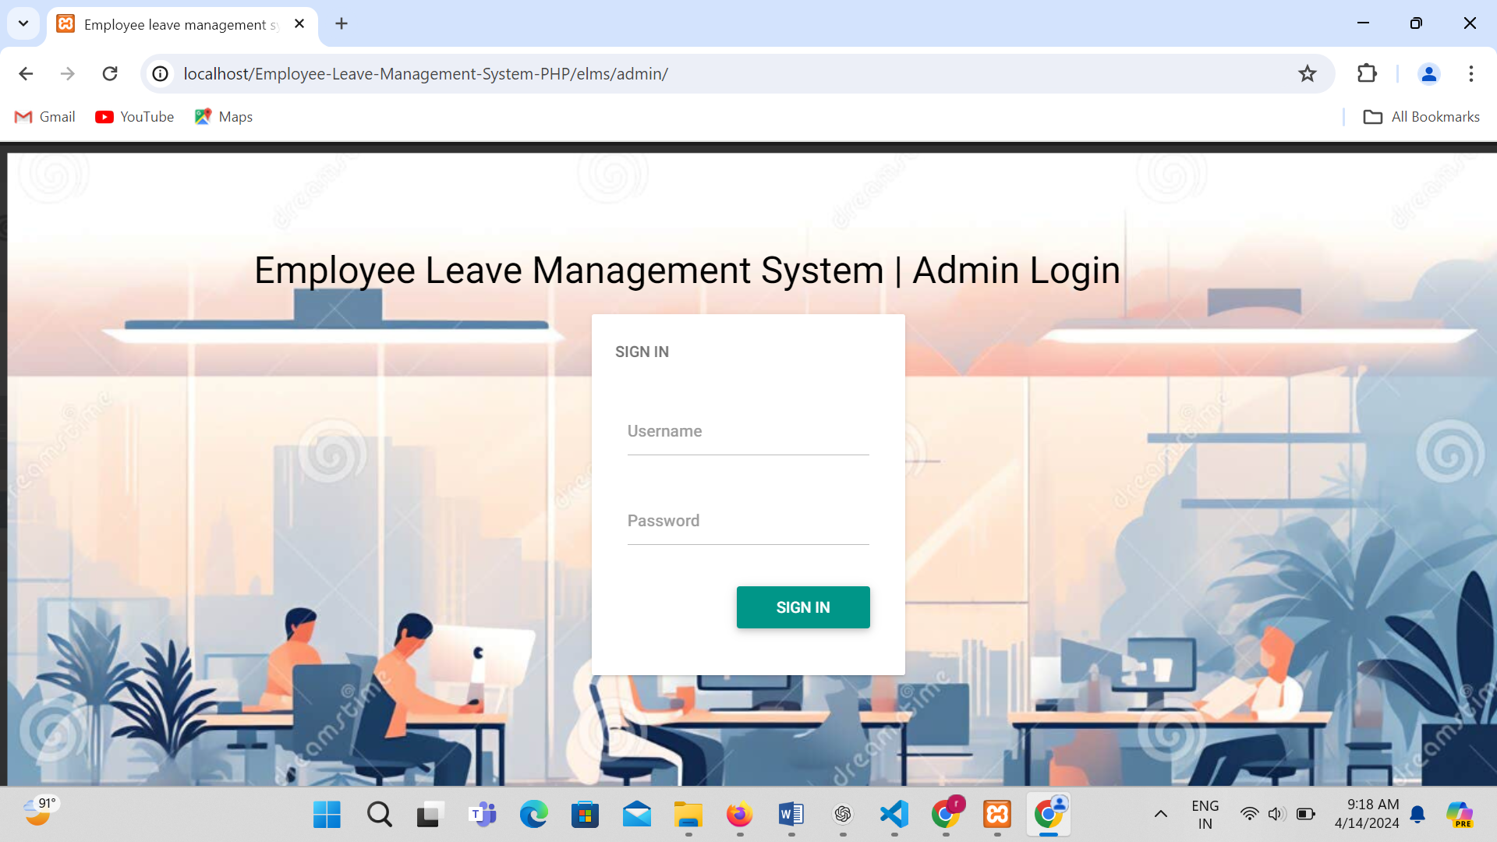
LOGIN PAGE OF ADMIN

Slide 15
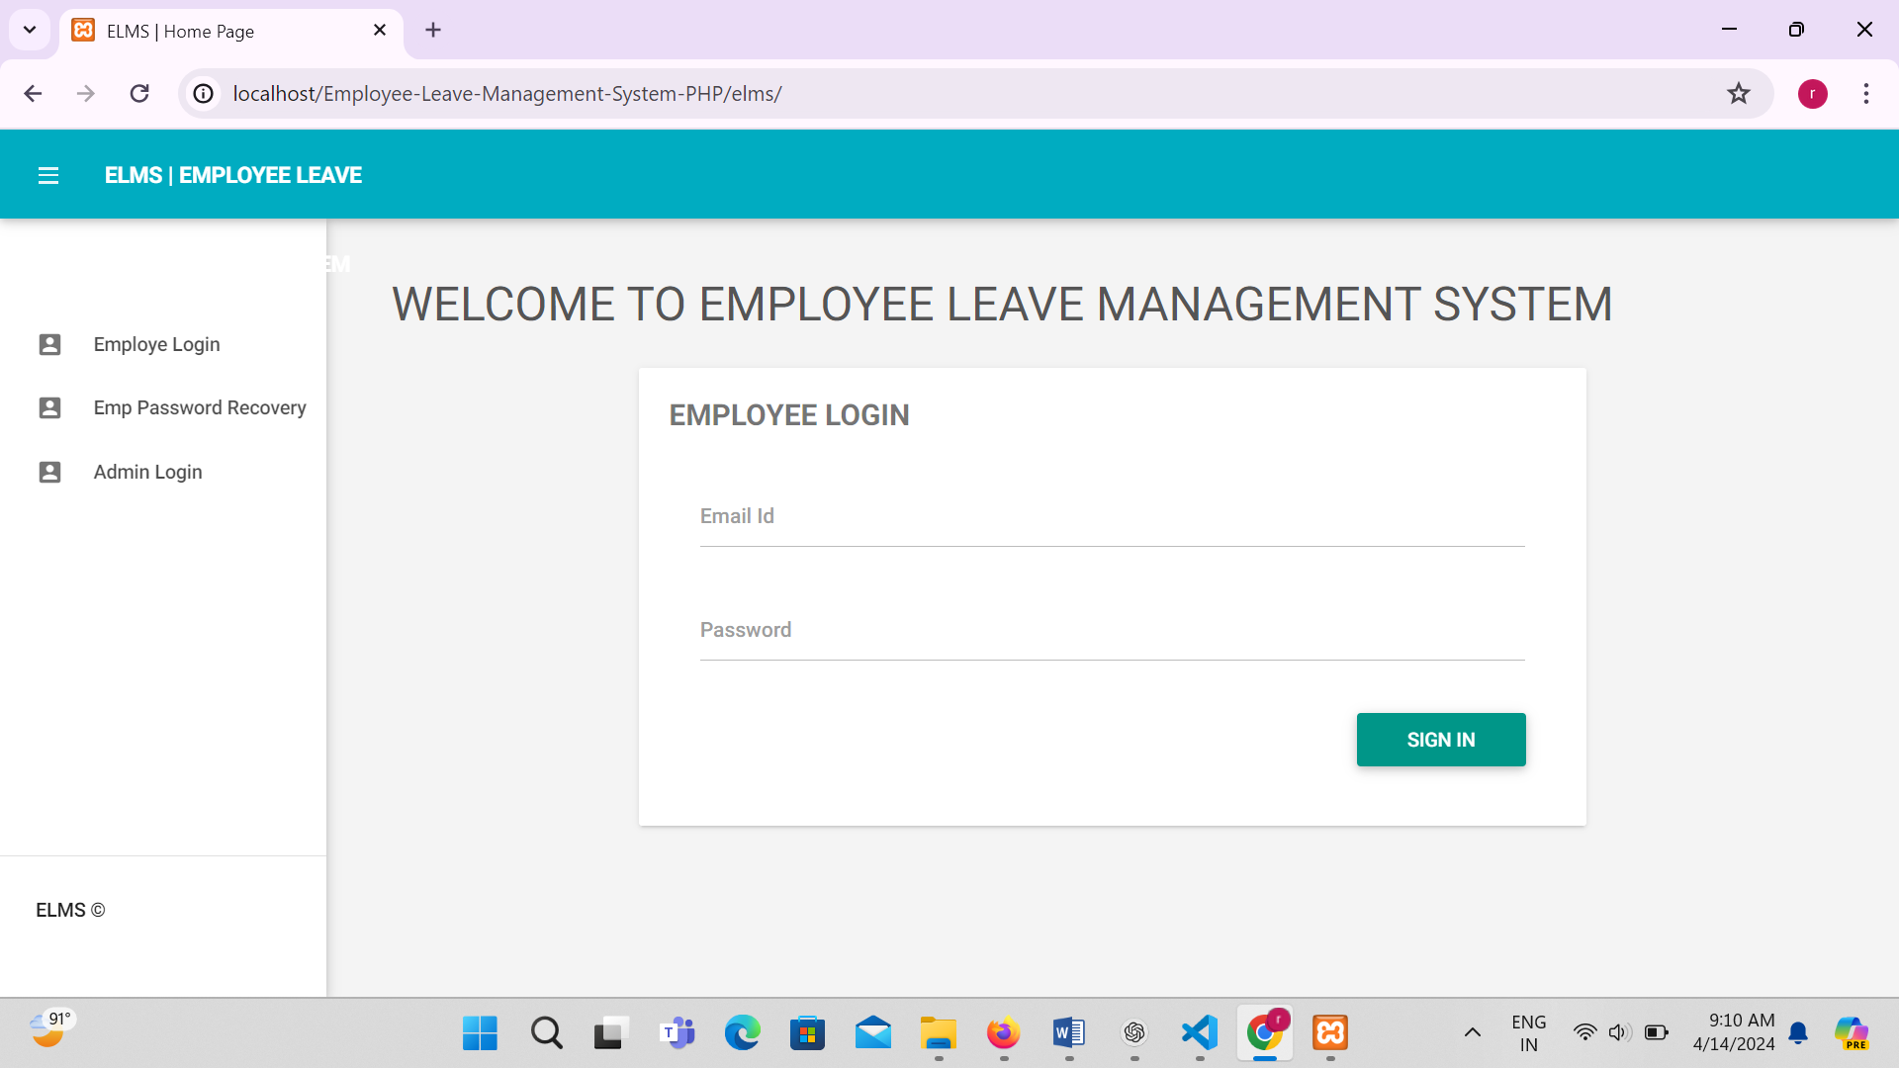
LOGIN PAGE OF EMPLOYEE

Slide 16
CONCLUSION
Leave Management System is very useful for college to maintain the leave record of the students and employees. This system not only maintain the leave details of the staff, It also maintain the leave applications of the staff and students.
The higher authorities may accept or reject the leave applications requested by the staff. Thus this system maintains the excess amount of job done by college to maintain the leaves.

Slide 17
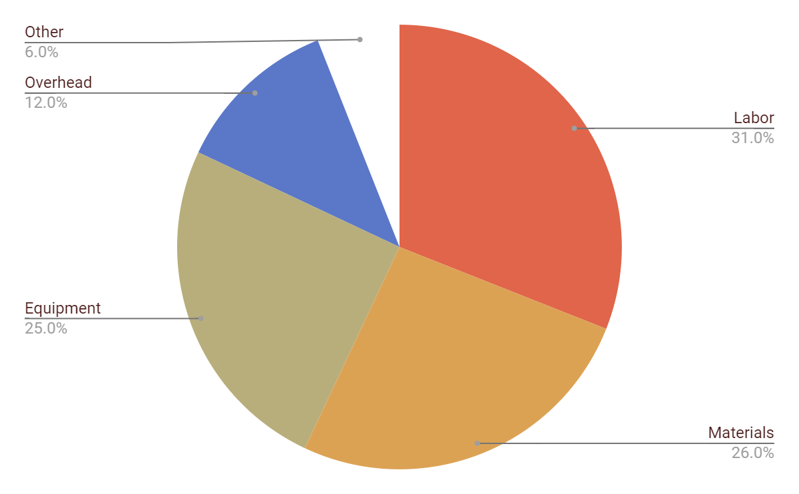
Leave
Rejected Leave
Padding Leave
Accepted Leave
Wait Leave
Other

Slide 18
THANK YOU

